Slide 1



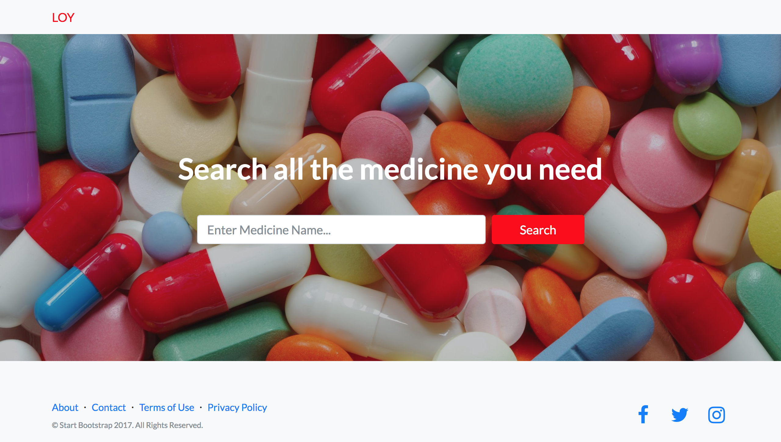
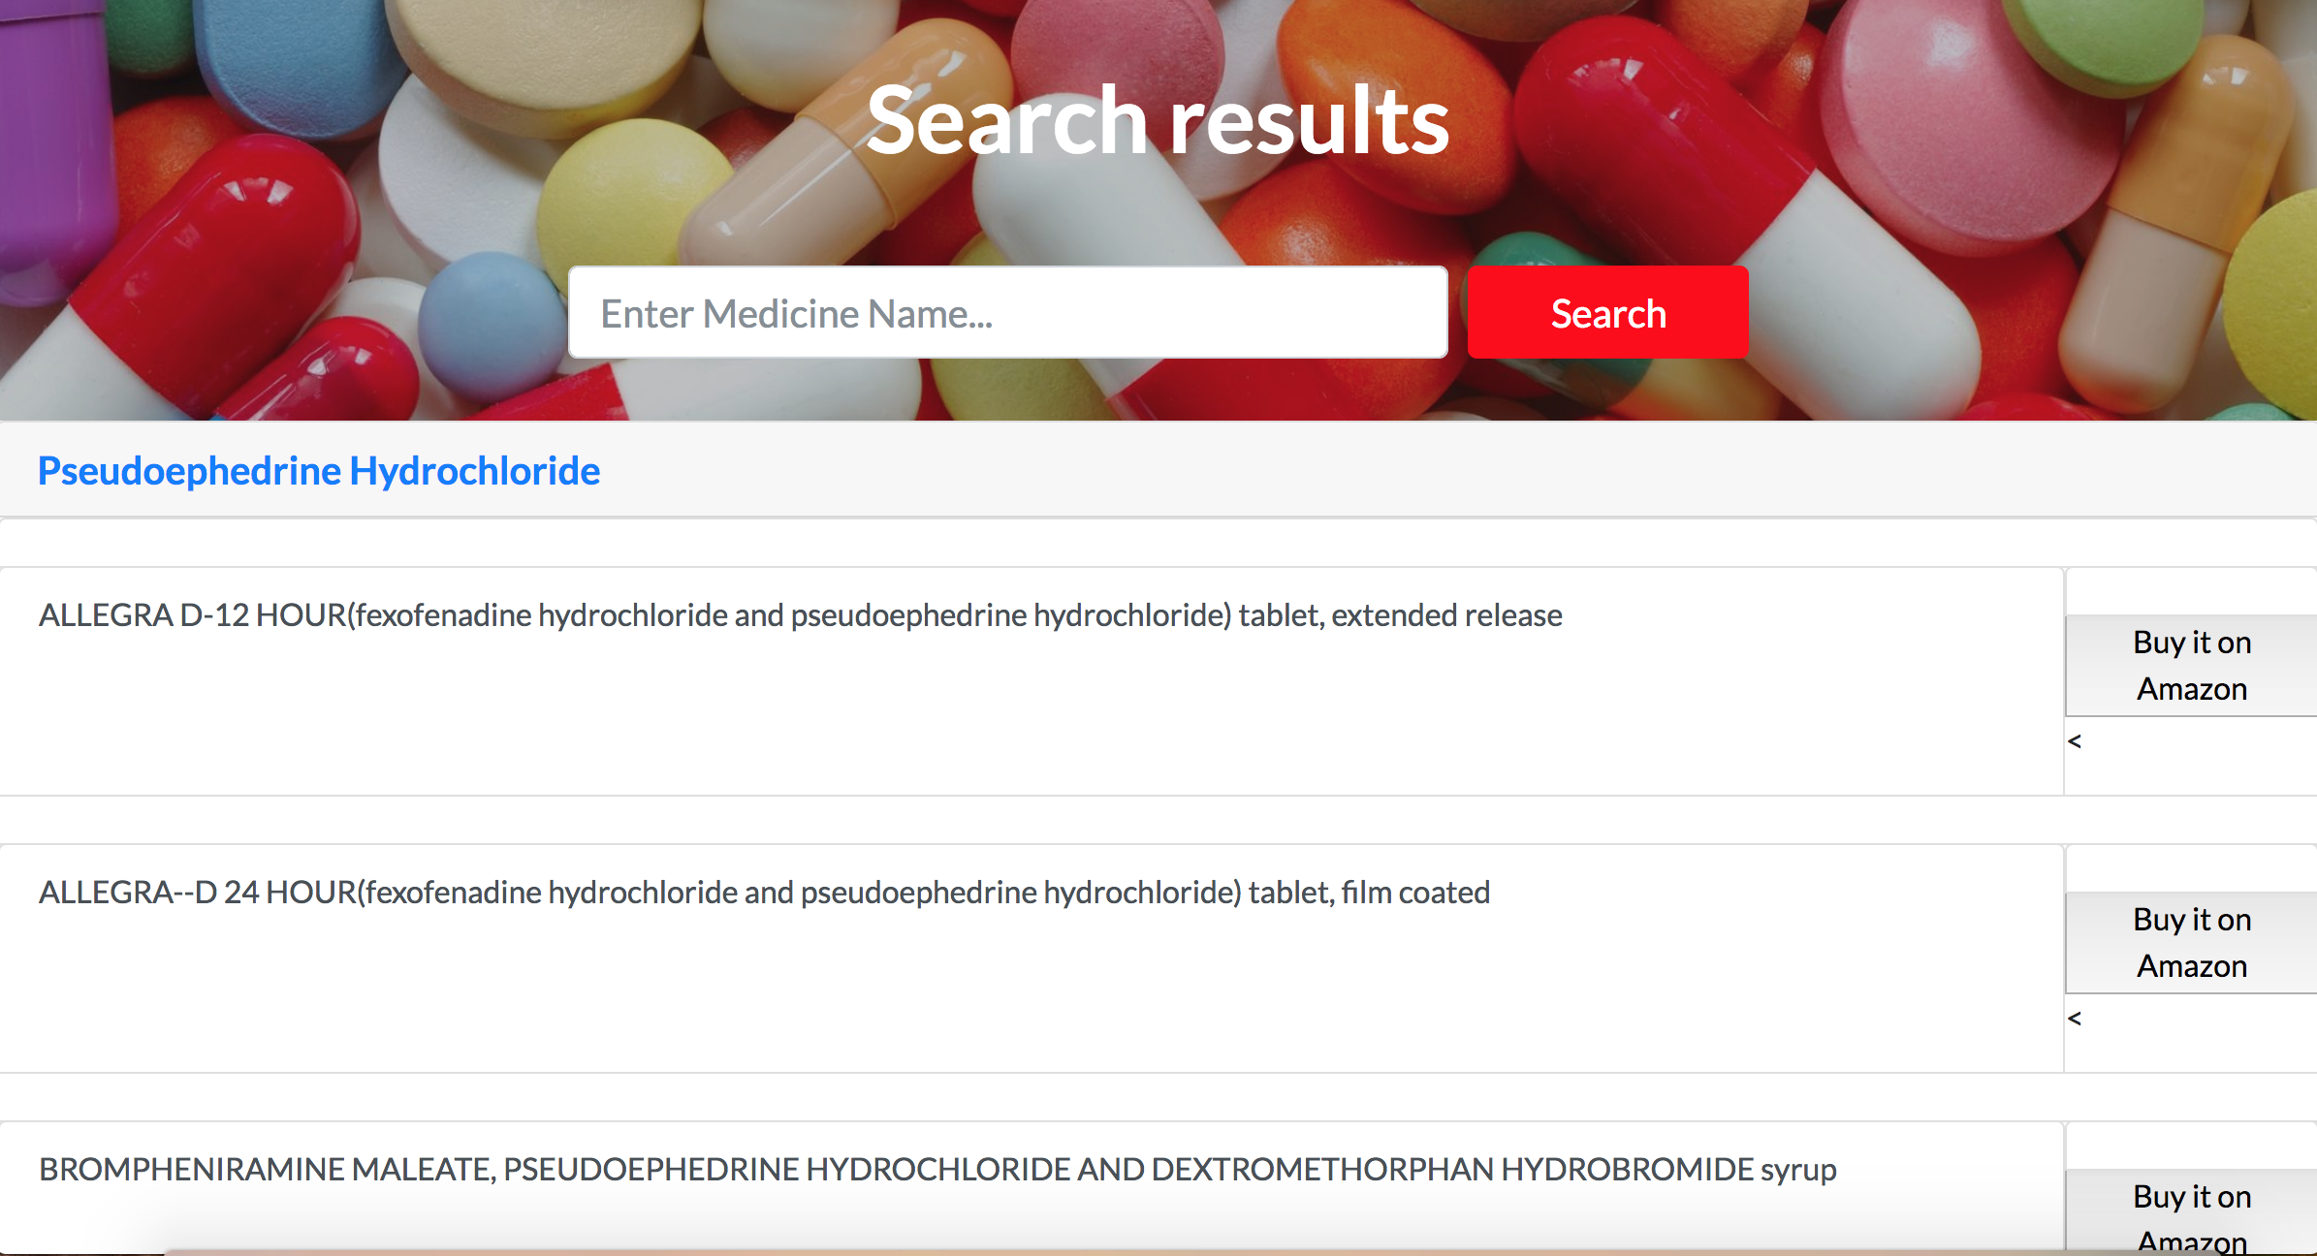
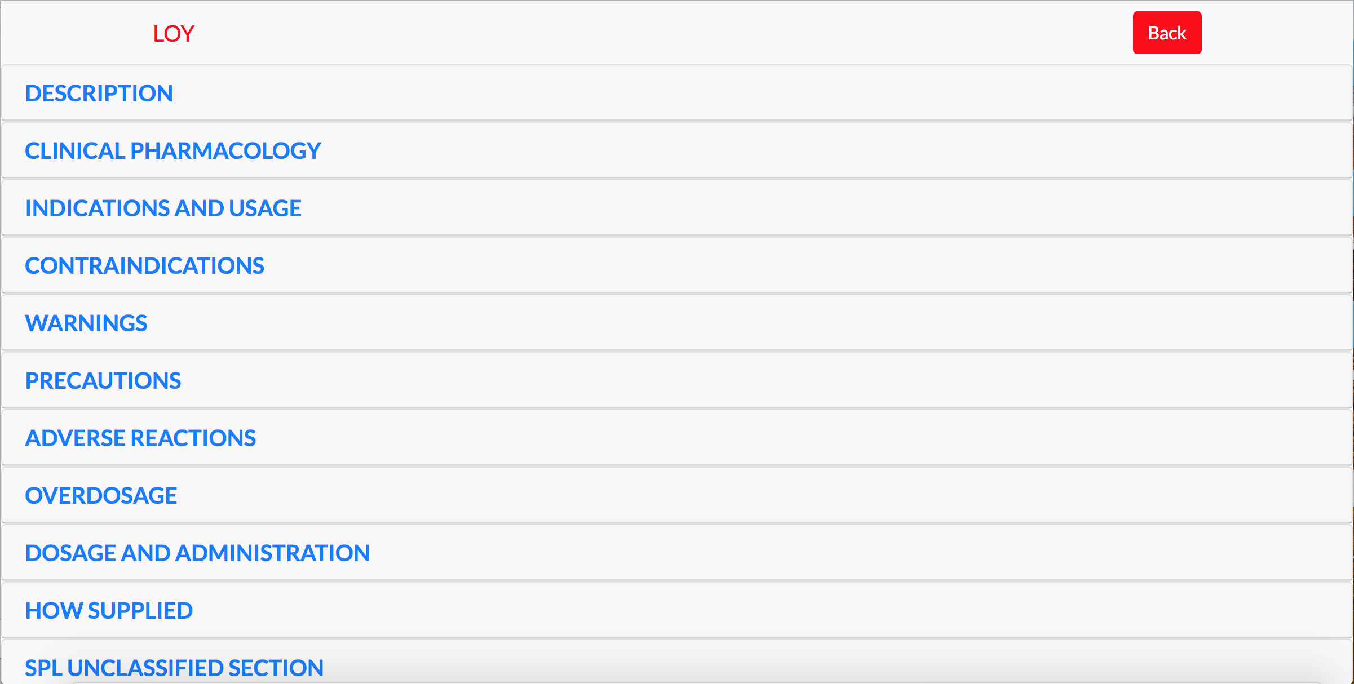
LOY
Present by: Lin Li,
Sailung Yeung,
Yiding Ou
Problem solved: Help foreign(Chinese) students and travelers find medicines that equivalent to their familiar medicines.
Custom Profile: Foreigners cannot understand medicine descriptions and ingredients. Or too sick to buy medicines.
Pivots: At first, I want to implement a Uber like delivery system, after that I pivot to this topic.
Solution:
1: User type in their familiar medicine with their native language
2. Application take input, using Chinese API get the ingredient of that medicine.
3. Using ingredient to find the relative equivalent U.S. medicines.
4. User can further read the description of that medicine (prescription or not).
5. Give Amazon purchase link, user can get this medicine online.
Tools:
Python Django framework
JavaScript front end.
Python pyquery library
BeautifulSoup library
Web crawler technique
Web crawler technique
Designed and implemented a keyword searching algorithm
Modified web crawler.
Edit the original description.
Using Amazon API
Using bottlenose library to request the API.
Future work:
1. Implement a database and for each time a user search, we store the relationship.
2. Find more APIs or datasets, expand the language to others except Chinese.
3. Add a delivery service for those who are too sick to get up and buy medicine.
4. Implement a chat box for immediate customer service.
5. Implement medicine scanner to allow users to find their desired medicine efficiently.

